Slide 1
Indirect or community protection and prioritization of malaria interventions
PhD Update
Sep 2025

Slide 2
Background
Funding for malaria control is declining, below what is required to reach global targets. As a result, there is an urgent need to reprioritize malaria interventions
Impact of interventions is usually measured in terms of direct protection. Yet, benefits to non-users (indirect effects) are critical but not often considered.
Ignoring community effects leads to biased estimates of health impact and cost-effectiveness
To assess the effectiveness of these interventions in an unbiased manner, their broader effects throughout the population should be considered, including among those not directly receiving the intervention
We aim to use mathematical modeling to simulate malaria transmission under various scenarios and quantify direct and indirect protection, compare LLINs and SMC in Ghana as a case study and provide evidence to support intervention prioritization under constrained resources.

Slide 3
Approach
Focus on one district – Biakoye in Oti region
Simulate malaria transmission dynamics, varying LLIN and SMC coverages - (0, 0.2, 0.4, 0.6, 0.8, 1)
LLIN deployed starting 2021, 2024, 2027
SMC deployed from July to October (4 cycles), starting 2023
Calculate cases averted per person protected (CAPP)

Slide 4

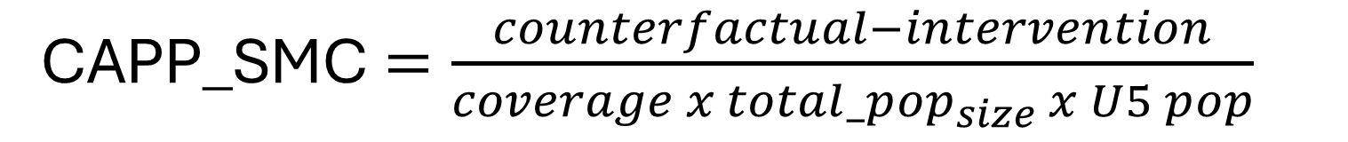
Cases averted per person protected
CAPP_LLIN $=\frac{counterfactual−intervention}{coverage x total_pop_{size}}$
CAPP_SMC$=\frac{counterfactual−intervention}{coverage x total_pop_{size} x U5 pop}$
Total_pop_size = 10000
U5_pop = 14.19%

Slide 5
Plots of Uncomplicated Cases averted per 1000 people protected in 0-100
Cases averted per 1000 people protected vs coverage
Decreasing means saturation effect
Increasing meanss indirect protection
Flat line means no indirect protection

Slide 6
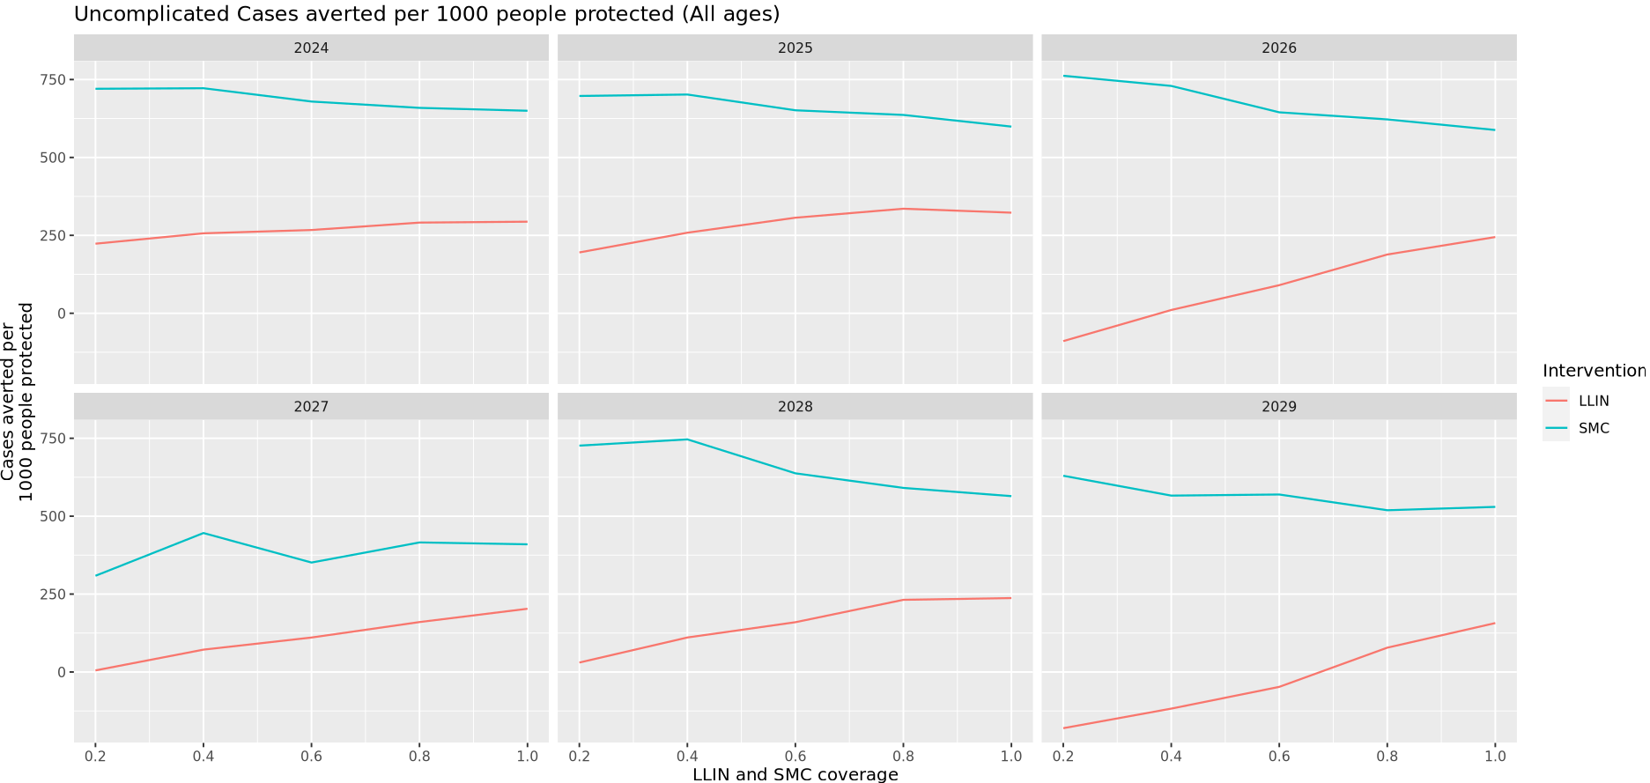
Uncomplicated Cases averted per 1000 people protected in 0-100

Slide 7
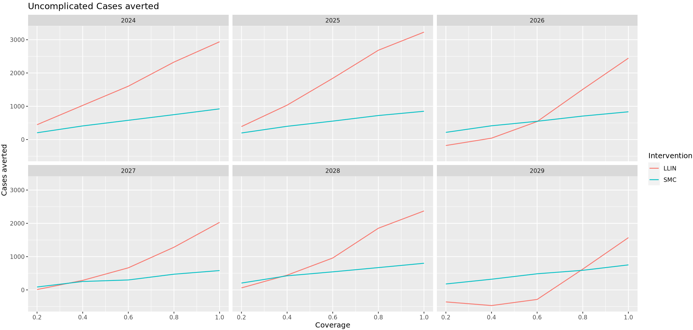
Uncomplicated Cases averted in 0-100

Slide 8
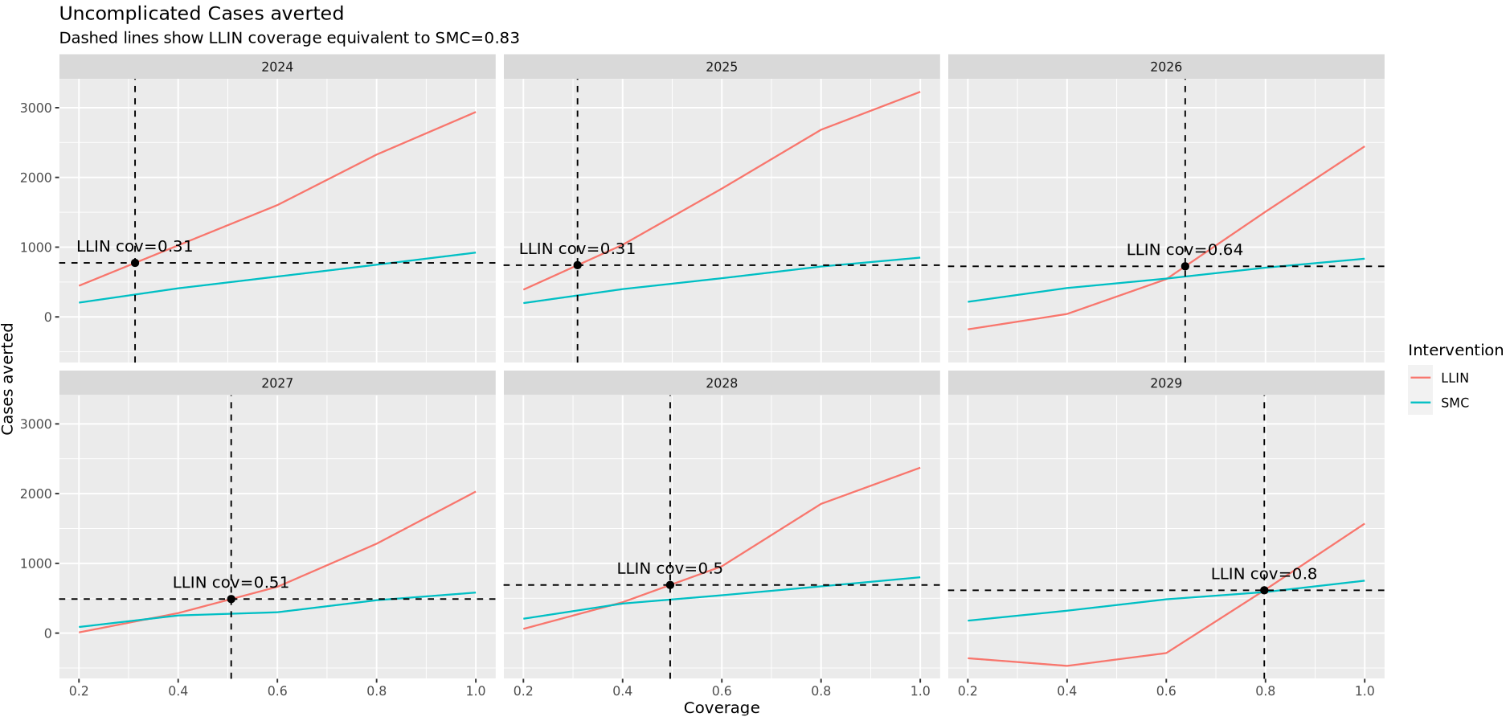
SMC equivalent LLIN coverage in 0-100

Slide 9
Cost of LLIN to achieve SMC-equivalent impact in 0-100 (example)
People protected
SMC (83% of under-5s, where under-5s = 14.2% of 10,000 = 1,420)
0.83×1,420=1,178.6
Unit cost
SMC: $2.4 per cycle × 4 cycles = $9.6 per child per year
SMC total cost
1,178.9.6×6x3years = $33,926.4
People protected
LLIN (64% of 10,000)
0.64×10,000=6,400
Unit cost
LLIN: $2.9 per net, 2.5 people per net
-> 2.9/2.5 = $1.16 per person protected
LLIN total cost
6,400×1.16 = $7,424
To avert the same number of cases:
LLIN (64% coverage) costs $ 7,424
SMC (83% coverage) costs $ 33,926.4
So LLIN is roughly 5 times cheaper to achieve the same impact.

Slide 10
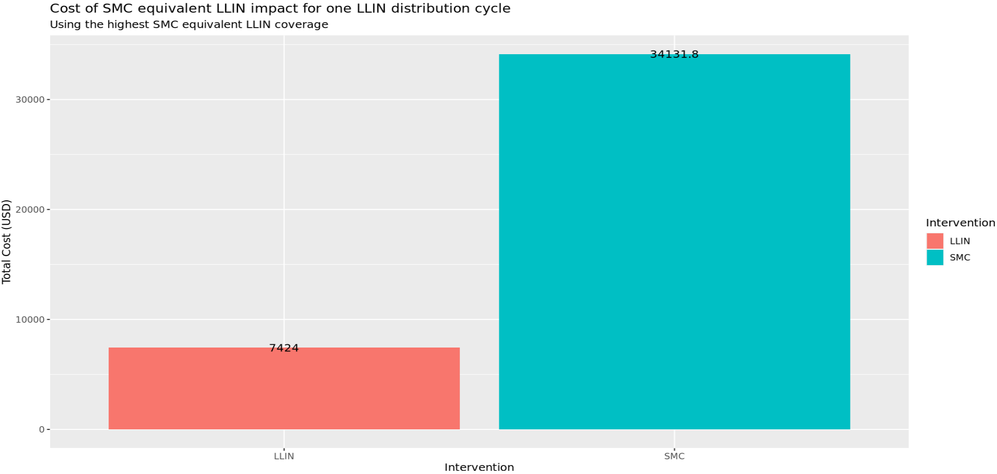
Cost of SMC equivalent LLIN impact in all ages

Slide 11
Regression analysis
This analysis will allow us to summarize and quantify the average relationship between coverage, EIR, and cases averted, rather than relying on raw curves from individual simulations.
Here, we built an explanatory model using the simulated data to reveal and quantify this relationship
Model:
Cases averted = b0 + b1 *coverage + b2 * coverage^2 + b3*EIR + b4*(coverage x EIR) + ε
This equation assumes that the uncomplicated cases averted by an intervention (ie. LLIN / SMC) is the sum of some base level (b0), contributions of coverage of the intervention (b1), the square of the coverage (b2), the transmission intensity (b3) and of the interaction between coverage and transmission intensity (b4), and a random normally distributed quantity (ε)

Slide 12
Regression analysis
b1 – direct effect of coverage
b2 – indirect effect of coverage
This will allow to quantify the average uncomplicated cases averted by an intervention (ie. LLIN / SMC) at a given coverage and transmission intensity as:
E[Cases averted] = b0 + b1 *coverage + b2 * coverage^2 + b3*EIR + b4*(coverage x EIR)

Slide 13
Regression analysis - Data
Data structure for analysis
Simulation results were collated into a single dataset with identifiers for year, random seed, EIR level, and coverage level.
Restricting the analysis to the period 2024–2029 (representing two cycles of LLIN distribution) allowed focus on medium-term impacts after intervention scale-up.
Each row in the dataset represents one simulated outcome under a given scenario, seed, and EIR level.
Number of obs = 105,840

Slide 14
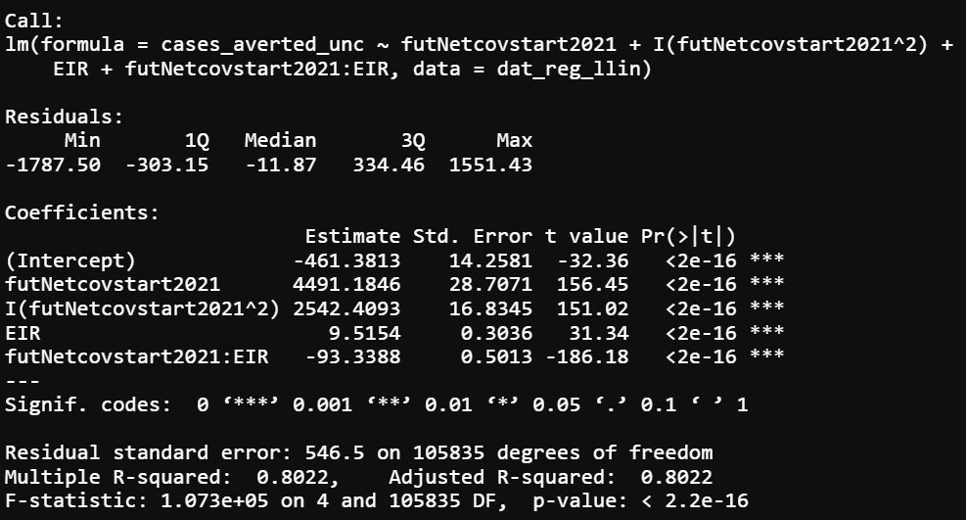
Regression analysis – Simple Linear regression - LLIN

Slide 15
Regression analysis – Coefficients - LLIN
 | Estimate | Interpretation
Intercept | -461 | At zero coverage & zero EIR, predicted cases averted ≈ -461
Coverage (direct effect) | +4491.4 | Each unit increase in LLIN coverage (0-1 scale) is associated with 4491 cases averted
Coverage (indirect effect) | +2542.4 | Positive curvature implies as coverage increases, the impact accelerates (non-linear benefits)
EIR | +9.5 | Higher EIR implies more cases averted
Coverage × EIR | -93.3 | at higher EIR, the marginal benefit of increasing coverage is smaller. (Indirect protection saturates faster under intense transmission)

Slide 16
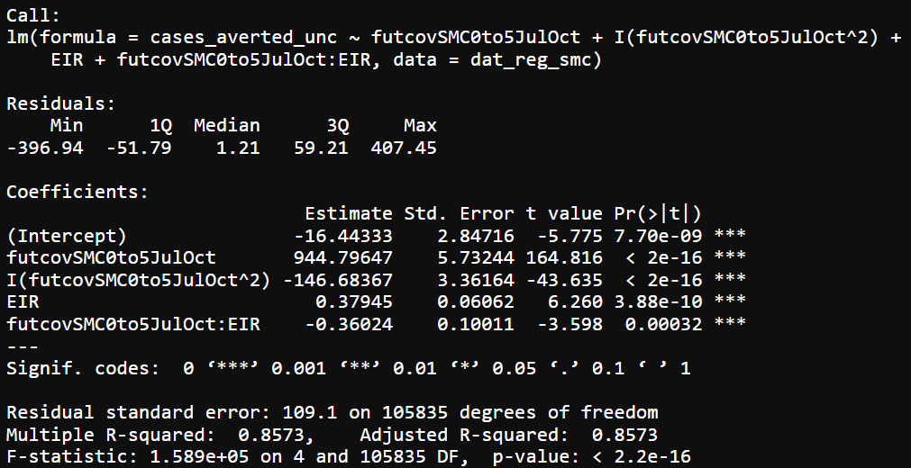
Regression analysis – Simple Linear regression - SMC

Slide 17
Regression analysis – Coefficients - SMC
 | Estimate | Interpretation
Intercept | -461 | At zero coverage & zero EIR, predicted cases averted ≈ -16
Coverage (linear effect) | +944.8 | Each unit increase in SMC coverage (0-1 scale) averts ~945 cases. Much smaller than LLIN effect because SMC only targets children 0–5 years
Coverage (quadratic effect) | -146.7 | Negative curvature implies diminishing returns at higher coverage. The first increments of SMC coverage avert the most cases; gains flatten at high coverage
EIR | +0.38 | At higher EIR, slightly more cases are averted, but the effect is modest
Coverage × EIR | -0.36 | Negative interaction: at higher EIR, the marginal benefit of increasing SMC coverage decreases (similar to LLIN but much weaker)

Slide 18
Regression analysis – Coefficients – LLIN and SMC
 | LLIN Estimates | SMC Estimates
Intercept | -461 | -461
Coverage (linear effect) | +4491.4 | +944.8
Coverage (quadratic effect) | +2542.4 | -146.7
EIR | +9.5 | +0.38
Coverage × EIR | -93.3 | -0.36

Slide 19
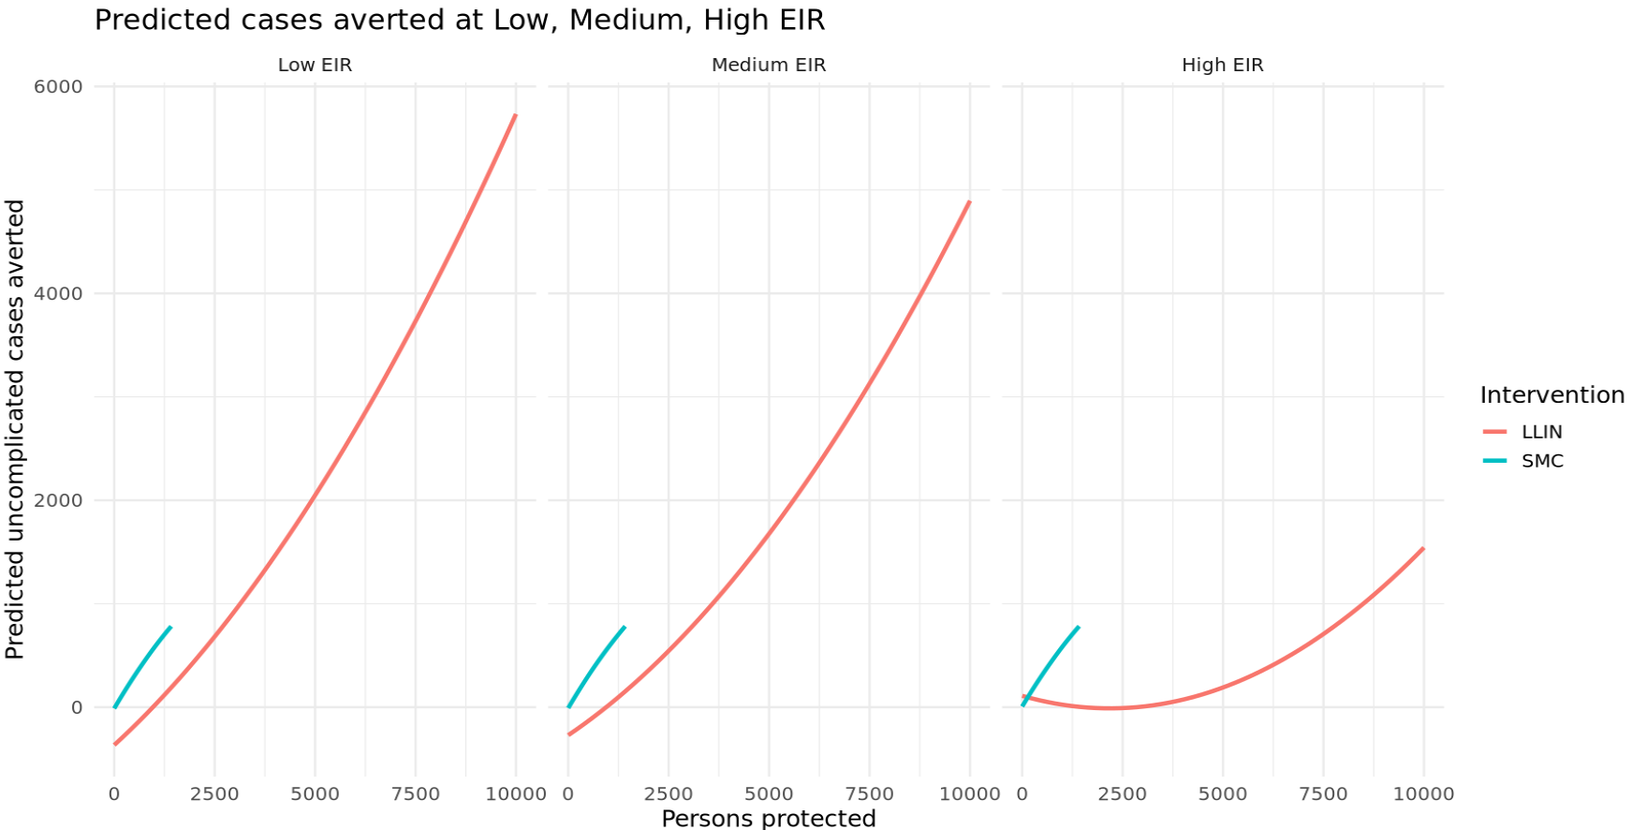
Predicted cases averted at different transmission intensities

Slide 20
Summary of insights
LLIN coverage strongly reduces malaria cases, with a convex (accelerating) relationship.
Baseline transmission (EIR) matters: higher EIR increases absolute cases averted (more to prevent), but the efficiency of nets per unit coverage declines in very high transmission settings.
This captures indirect protection dynamics:
At low/medium EIR → indirect (community) protection amplifies coverage impact.
At very high EIR → mosquito pressure overwhelms nets, so coverage gains decline.

Slide 21
Summary of insights
SMC averts fewer absolute cases compared to LLINs, consistent with its focus on children under 5 only (direct protection).
The coverage effect is strong at low-to-moderate coverage, but flattens at high coverage diminishing returns (since most at-risk kids are already covered).
EIR effect is minor: increasing transmission intensity doesn’t boost SMC’s effect much, because it only protects a subset of the population.
LLINs provide both direct and indirect protection (community effect), hence large, accelerating gains.
SMC provides mainly direct protection, hence linear with slight diminishing returns.

